Slide 1
JavaScript - DOM (Day 3)
Viktoras Lava www.viktoraslava.lt

Slide 2

What is DOM?
The DOM stands for Document Object Model.
It represents an HTML or XML document so that programs can change it’s structure, style and content.
The DOM standard is defined by WHATWG and W3C, however every browser interprets the DOM with a slight difference.

Slide 3
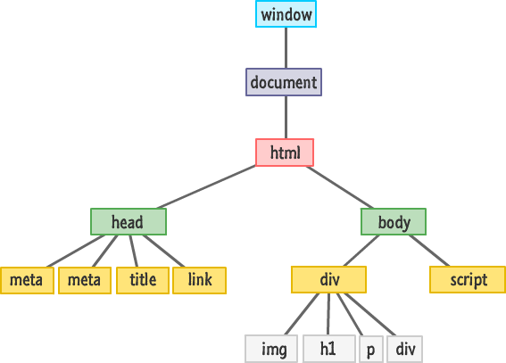
How DOM looks like?
Sometimes DOM is also called a DOM tree as it visually represents a tree like structure of the HTML document.
There 2 main DOM elements inside every HTML document:
window
document

Slide 4
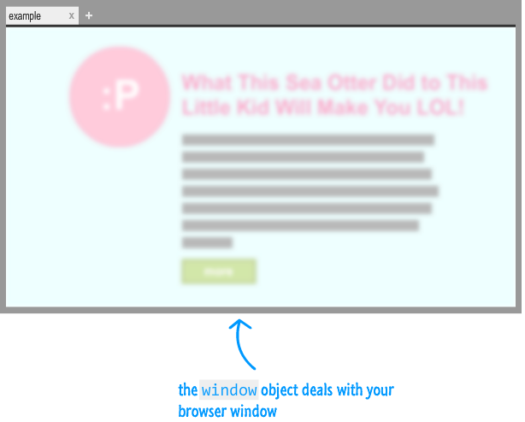
Window object
In the browser the root of your hierarchy is window object.
It contains many properties and methods that help you to work with the browser.
The list of window object properties and methods is here.

Slide 5
Important properties and methods for window object
Properties:
screen
location
localStorage or sessionStorage
onload (event)
onresize (event)
onscroll (event)
Methods:
alert(), confirm(), prompt()
console.log()
print()
scroll() or scrollTo()
matchMedia()

Slide 6
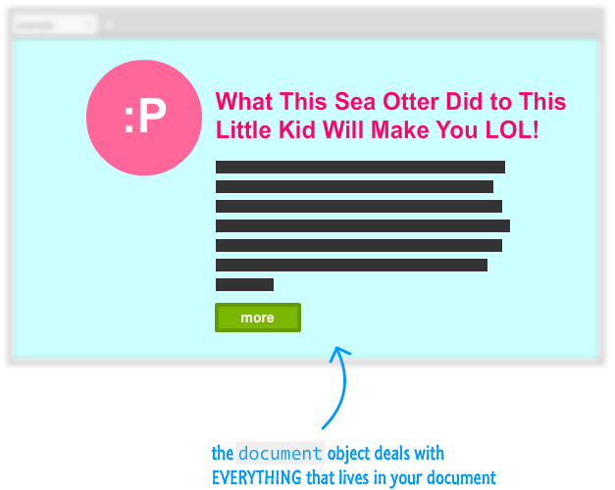
Document object
Document object is a gateway to all of the HTML element’s content and styles.
This is where you will spend most of your time manipulating the document.
The list of document object properties and methods is here.

Slide 7
Important properties and methods for document object
Properties:
title
scripts
referrer
links
Methods:
getElementById()
querySelector()
querySelectorAll()
createElement()

Slide 8
Questions?

